Slide 1

ArunDina
Marketing Campaign

Slide 2
Team Members
Abdelrahman Abdelnaser
Aya
Muhamed
Fatma
Rehab
Mahmoud

Slide 3
Repeated
Abdelrahman Abdelnaser
Aya
Muhamed
Fatma
Rehab
Mahmoud

Slide 4
Introduction
Brief About The Business

Slide 5

Background Project
Current scenario:
Warner & Spencer has been a significant player in its industry, offering various shampoo and soap products. While they've seen success, we acknowledge the evolving market dynamics and the need to adapt our sales strategies to maintain and increase our competitive edge.

Slide 6
Campaign Goals
Primary Goal: Increase Awareness About ArunDina.
Secondary Goal: Increase Revenue.

Slide 7
Tools
Data Collection:
Google Suit.
Graphics Tools:
Canva.
Photoshop.
Capcut.
Testing and Refinement:
Pilot the proposed strategies on a smaller scale to assess their effectiveness.
Gather feedback, iterate, and refine the strategies based on initial results.

Slide 8
Channels
FaceBook
Instagram
Tik Tok
WhatsApp

Slide 9

Sales Performance Analysis
Current Sales Trends:
Over the past years, we've observed Warner & Spencer’s product sales going down because of some reason.
Market Insights:
Through comprehensive market analysis, we've identified shifts in consumer preferences, competitive landscape changes, and emerging market segments.
Customer Feedback:
Direct feedback from our customers has highlighted areas for improvement

Slide 10



Project Objectives
Analysis Phase
Strategy Development
Analyze sales performance, market trends, and consumer behavior.
Conduct a SWOT analysis of existing sales strategy.
Create new strategies using marketing, sales promotions,
Customer engagement to leverage strengths and opportunities.
Implementation Plan
Create a timeline with milestones
And responsibilities. Set KPIs to measure success.

Slide 11

Expected Outcomes
Increased Sales Figures:
Target a 25% increase in sales over the next years.
Measure success by tracking sales metrics and revenue growth.
Improved Customer Engagement:
Foster stronger relationships with customers through personalized engagement strategies.
Increase customer retention rates and loyalty.
Enhanced Market Reach:
Expand market reach by tapping into new demographics or geographical regions.
Strengthen brand presence through effective marketing campaigns.

Slide 12
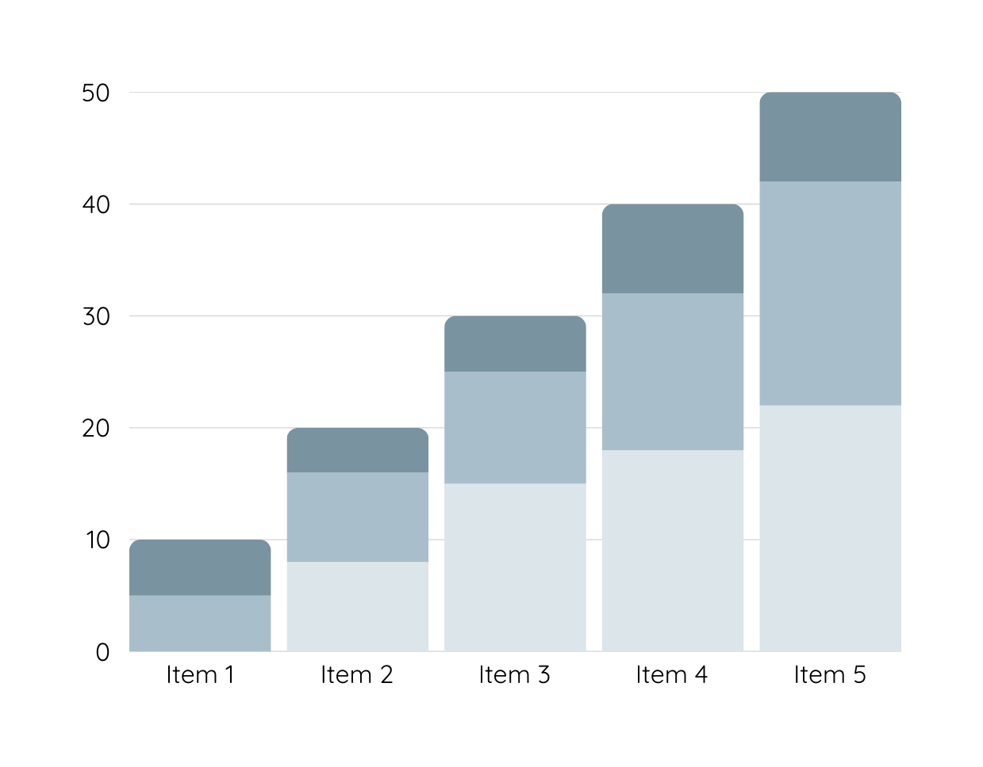
Data Analysis
Over the past year, sales for Warner & Spencer have experienced a consistent decline, dropping month-on-month. The graphical representation of sales volumes reveals a noticeable downward trend, especially in the last quarter.
Product 1
Product 2
Product 3

Slide 13
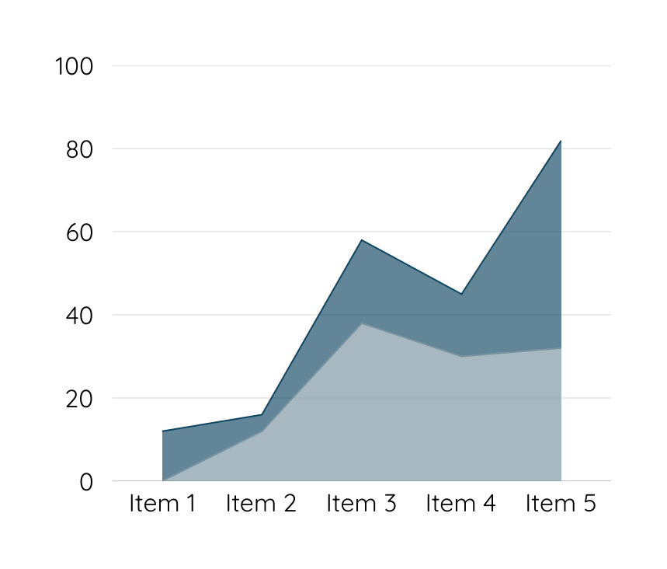
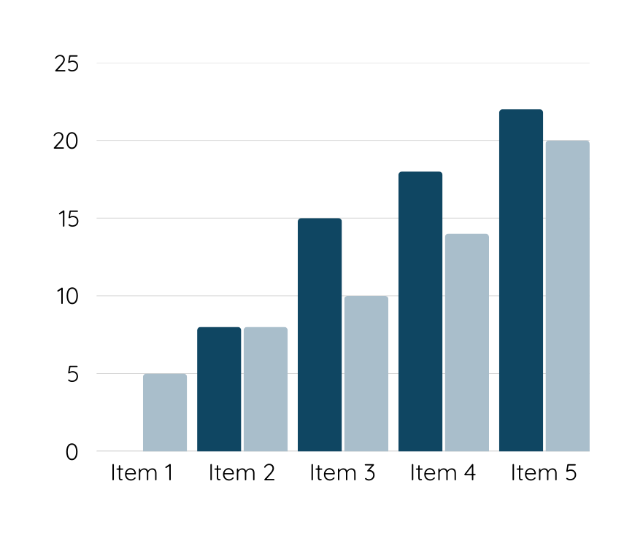
Data Analysis
Customers are unhappy with Warner & Spencer's new packaging, which may be contributing to a decline in sales. Competitors offer better features and pricing, making it difficult for our product to stand out in the market.

Slide 14
Conclusion
By implementing a well-researched and innovative sales strategy, our goal is not only to boost immediate sales figures but also to establish a sustainable framework for continued growth and success.

Slide 15
Thank you

